Slide 1
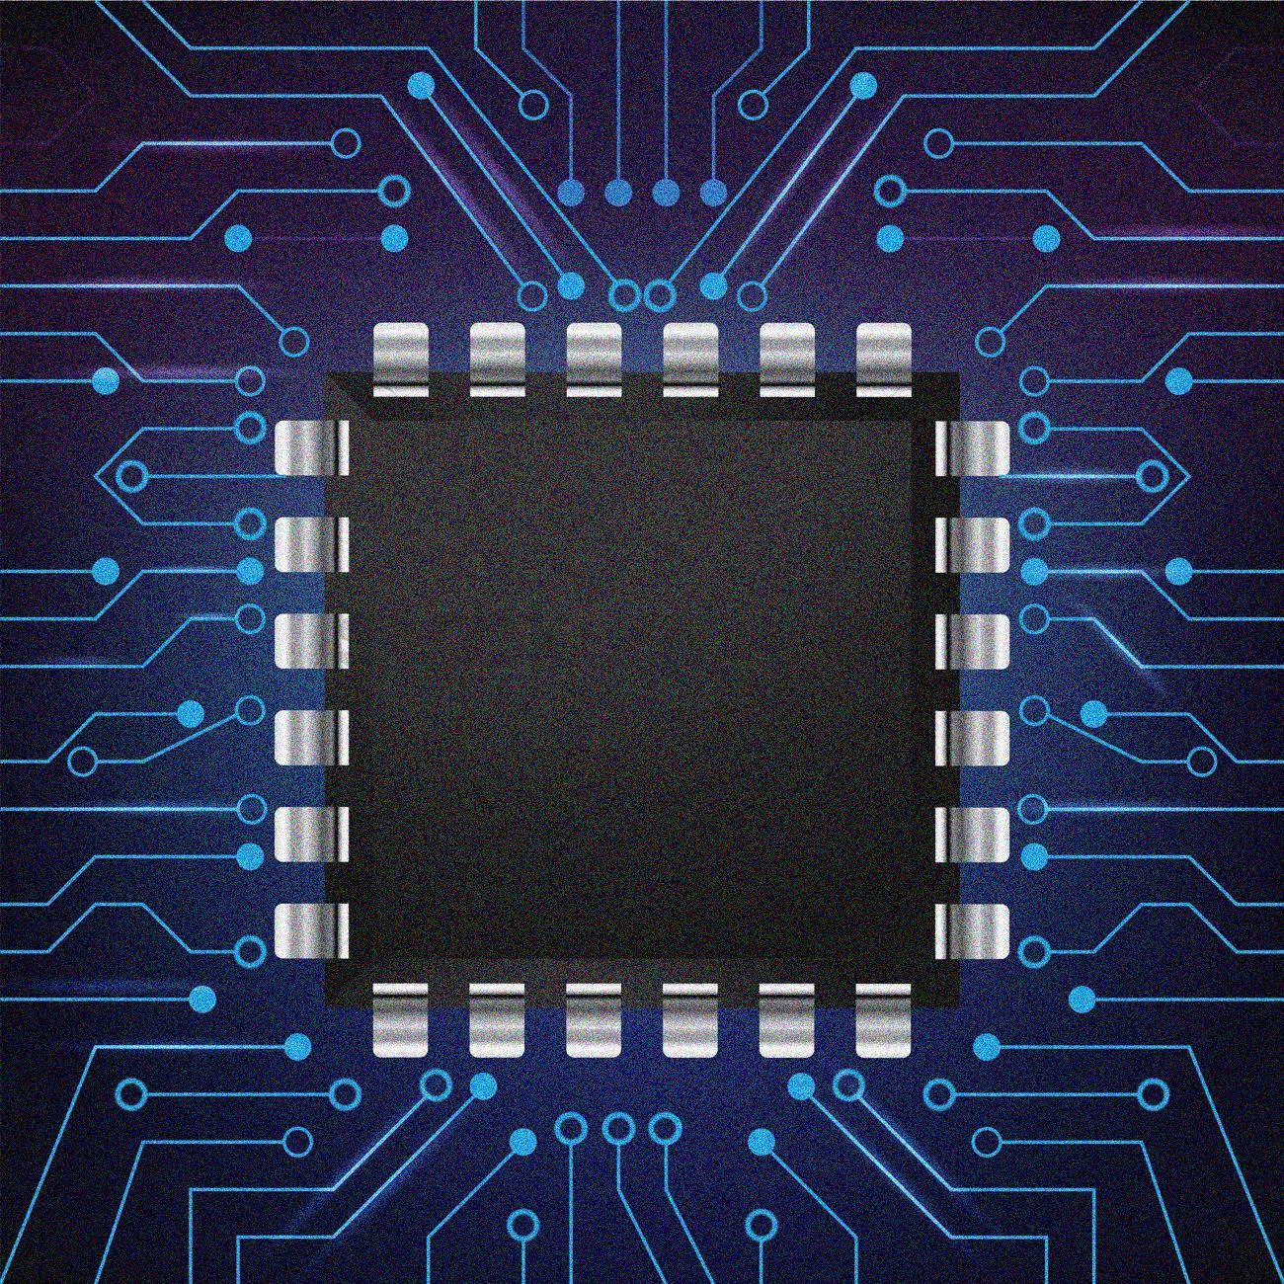
ITN GOD Bachelor of Electrical Engineering Project Damghan University

Slide 2

Project Title weather station researchers Mehdi jamshidi , mohammad ebrahim ebrahim toosi Supervisor Dr.behzad boghrati August 2020

Slide 3

Contents
Introduction…………………………………………………………………………………………………………1
Software Design
Microcontroller………………………………………………………………………………………………….…2
ARM…………………………………………………………………………………………………………………..…3
Cortex-m3……………………………………………………………………………………………………………4
Introduction to ST Company…………………………………..…………………………………………5

Slide 4

STM32CubeIDE……………………………………………………………………………………………….…6
J-link………………………………………………………………………………………………………………….…7
STM32F103CBT6…………………………………………………………………………………………….…8
Peripherals used in this project…………………………………………………………………..….…9
I2C………………………………………………………………………………………………………………………10
SPI…………………………………………………………………………………………………………………..…11
USB CDC…………………….……………………………………………………………………………..….…12
RTC………………………………………………………………………………………………………………...…13

Slide 5
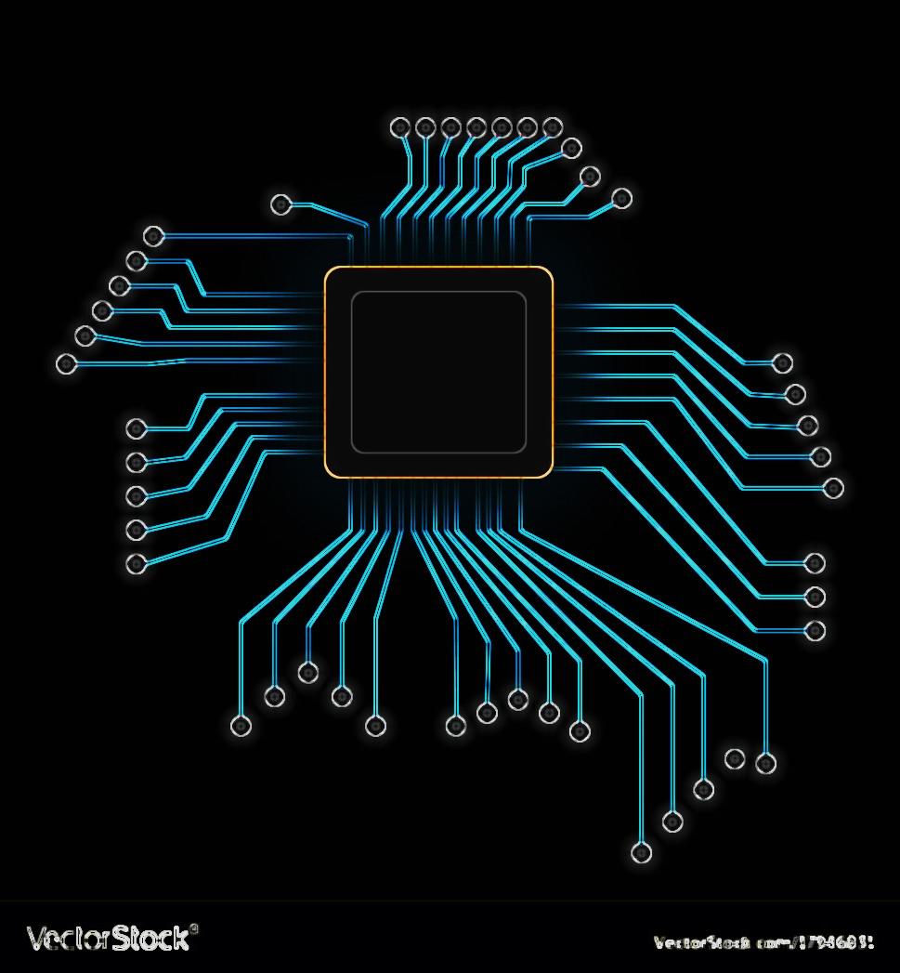
Modules used in this project……………………………………………………………….…….....…14
BMP-180……………………………………………………………………………………………………......…15
SRF-05…………………………………………………………………………………………………………...…16
AHT-10…………………………………………………………………………………………………..……....…17
LORA Ra-02…………………………………………………………………………………………………...…18
GY-49…………………………………………………………………………………..………………….……...…19
GY-271………………………………………………………………………………………………………......…20

Slide 6

Hradware Design
Introduction to Altium Designer………………………..…………………………………..........…21
Transmiter Shematic(1)………………………………………………………………………...........…22
Transmiter Shematic(2)………………………………………………………………………...........…23
Reciver Shematic……………………………………………………………………………………........…24
Transmiter PCB……………………………………………………………………..……....................…25
Reciver PCB………………………………………………………………………….…………...............…26

Slide 7

Desktop App
Introduction to Python……………………………………………………….…………...............…27
PyQt………..………………………………………………………………………….…………...............…28
sources and resources……..………………………………………………….…………...............…29
Contact us…………………………………………………….……………………….…………...............…30

Slide 8

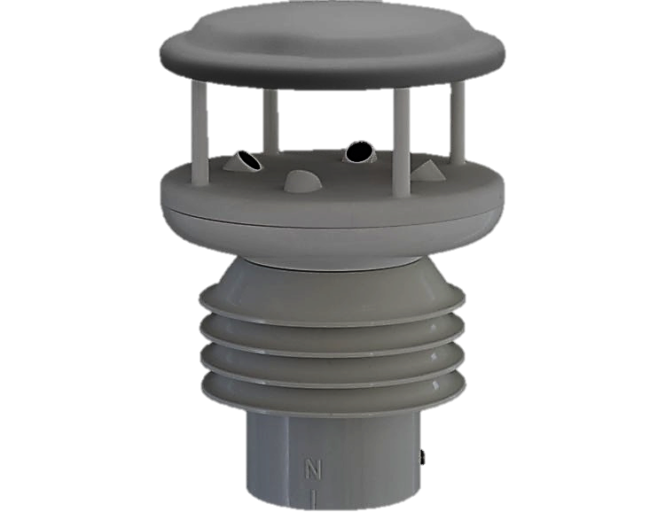
Introduction
In this project, we will implement a fully digital weather station with the microcontroller of the ARM and module of temperature, humidity, pressure, light intensity, Digital compass and ultrasonic sensors, and send the data by the Lora module, and on the other side, this data Received by the Lora module and sent to the computer.
1

Slide 9

Software Design

Slide 10

Microcontroller
A microcontroller is an integrated circuit or electronic chip that has a ROM , RAM, CPU, … and a number of programmable inputs and outputs.
Microcontrollers are microcomputers that are programmed for a specific purpose
2

Slide 11

ARM
ARM is an architecture (not a microcontroller) used to build 32-bit and 64-bit processors and is built by ARM Holdings.
The microcontroller that uses the ARM architecture is called the ARM microcontroller.
Due to the cheap price, high speed and low power consumption of these processors, most embedded systems (such as microcontrollers, mobile phones and tablets, and generally systems with small volume and high features) use this processor.
3

Slide 12

Cortex-m3
The cortex has 3 profiles:
A: Applications such as mobile phones
R: Real-time applications
M: Low power consumption applications
The number 3 in the cortex-m3 indicates the existence of 3 execution lines or performance line
4

Slide 13

Introduction to ST Company
ST is a French-Italian multinational electronics and semiconductor company headquartered in Geneva, Switzerland.
ST has been one of the most successful competitors in the field of microcontroller manufacturing among other manufacturers.
The company's products have been considered in the world for many reasons, including a variety of models and speed, low power consumption, libraries provided by the manufacturer, etc.
5

Slide 14
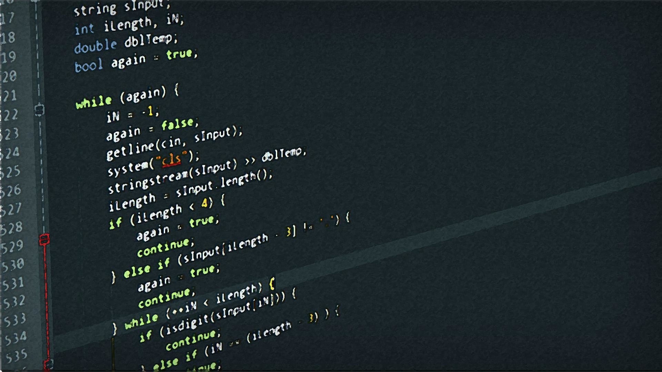
STM32CubeIDE
This software has been designed by ST Company for the convenience and no need of users to use user registers.
This software has many advantages, including:
_One of the advantages is the graphical selection of the required hardware, which at the end provides a project with the required files and ready-made functions.
_ Another feature of this software is that there is no need for software such as Kiel or IAR and you can write the program in the same software and program the code on the microcontroller.
And,etc.
6

Slide 15

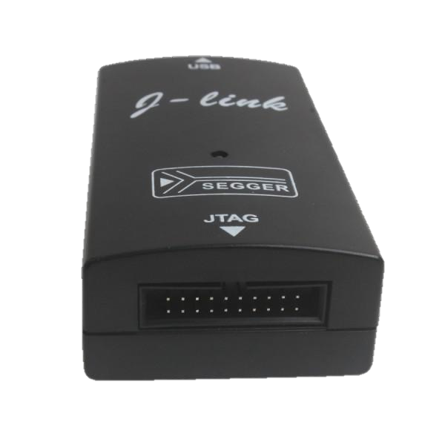
J-link
J-link programmer and debugger, designed and provided by SEGGER Group for programming and debugging ARM-based microcontrollers, can hex code or binary made by the compiler through the JTG microcontroller connector and the USB port of the computer Transfer to micro, this device is fully supported in Cube ID software and you can transfer your application directly to micro from it
7

Slide 16
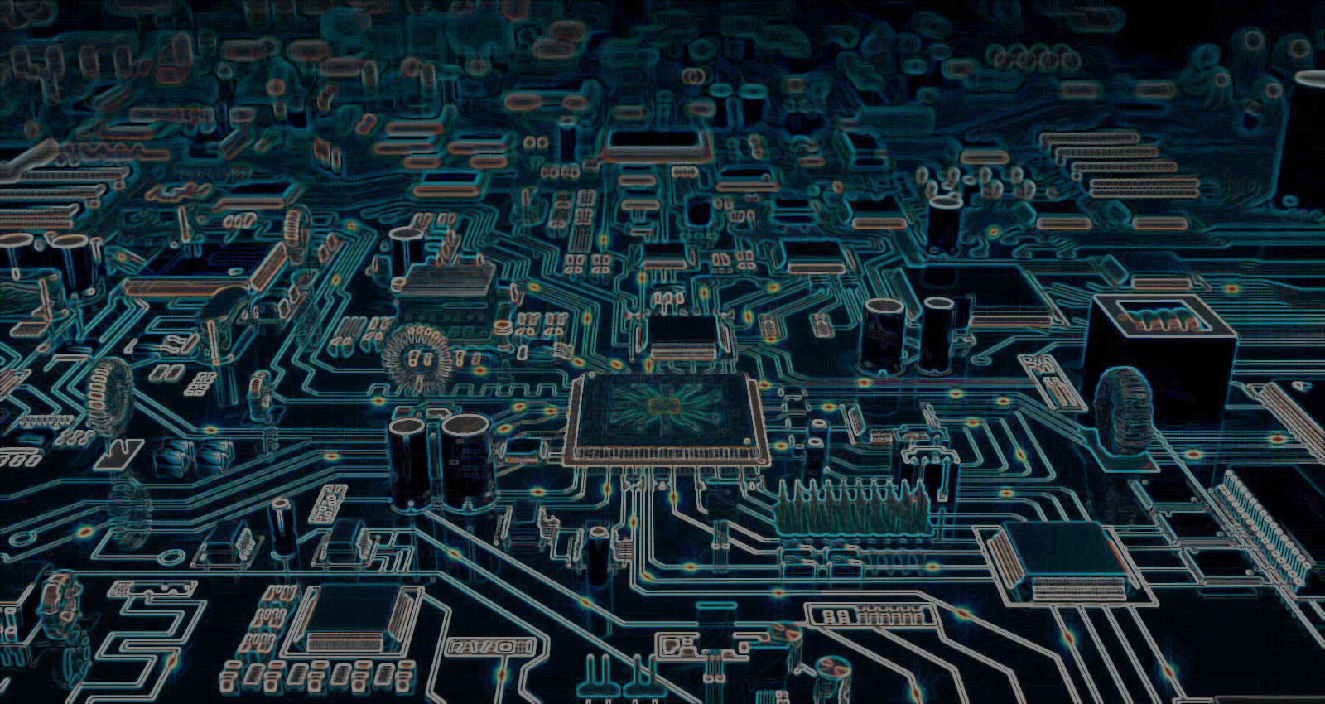
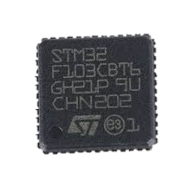
STM32F103CBT6
STM32F103CBT6
Package / Case | LQFP-48
Core | ARM Cortex M3
Data Bus Width | 32 bit
Maximum Clock Frequency | 72 MHz
Program Memory Size | 128 kB
Data RAM Size | 20 kB
Number of I/Os | 37 I/O
Operating Supply Voltage | 2 V to 3.6 V
Program Memory Type | Flash
Data RAM Type | SRAM
Interface Type | CAN, I2C, SPI, USART, USB
Minimum Operating Temperature | - 40 C
Maximum Operating Temperature | + 85 C
Brand | STMicroelectronics
8

Slide 17

Peripherals used in this project
I2C(Inter-Integrated Circuit)
SPI(Serial Peripheral Interface)
USB CDC(Communications Device Class)
RTC(Real Time Clock)
9

Slide 18

I2C
MASTER
SDASDA
SCKDA
SCK
SDASDA
SDASDA
SCK
SLAVE1
SLAVE2DA
VCCDA
10

Slide 19

SPI
MASTER
SLAVE
CS/SS
MISO
MOSI
CLK
Chip Select/Slave Select
SS/CS
MISO
MOSI
CLK
Ii
Uu
Master Input/Slave Output
Master Output/Slave Input
Clock
11

Slide 20

USB CDC
The Communication Device Class (CDC) supports a wide range of devices that can perform telecommunications and networking functions. Examples for communications equipment are:
-Telecommunications devices, such as analog phones and modems, ISDN terminal adapters, digital phones, as well as COM-port devices
-Networking devices, such as ADSL and cable modems, as well as Ethernet adapters and hubs.
A communications device has three basic tasks:
Device management (controlling an configuring a specific device and notifying the USB Host of certain events)
Call management (establishing and terminating telephone calls or other connections)
Data transmission (sending and receiving application data)
12

Slide 21

RTC
A real-time clock (RTC) is a computer clock (most often in the form of an integrated circuit) that keeps track of the current time.
Although keeping time can be done without an RTC,using one has benefits:
Low power consumption(important when running from alternate power)
Frees the main system for time-critical tasks
Sometimes more accurate than other methods
A GPS receiver can shorten its startup time by comparing the current time, according to its RTC, with the time at which it last had a valid signal. If it has been less than a few hours, then the previous ephemeris is still usable.
13

Slide 22

Modules used in this project
BMP-180(Barometric pressure module)
SRF-05(Ultrasonic module)
AHT-10(Temperature and humidity sensor module)
LORA Ra-02(Wireless transceiver module)
GY-49(Light Intensity Module)
GY-271(Three-axis compass module)
14

Slide 23

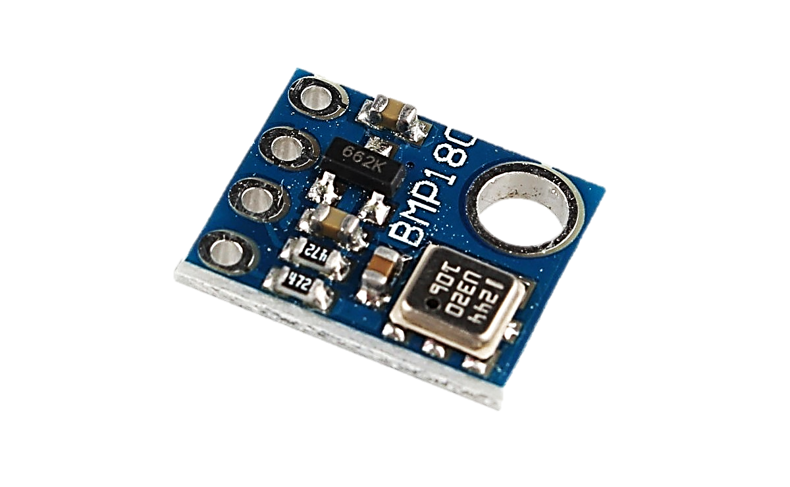
BMP-180
BMP180 is a high precision , small size , ultra-low power pressure sensor can be used in mobile devices Its performance, absolute accuracy can reach the lowest 0.03hPa.
BMP180 can be connected directly with a variety of microprocessor via the I2C bus.
Power supply voltage : 1.8V ~ 3.6V (VDDA), 1.62V ~ 3.6V (VDDD)
Pressure range : 300 ~ 1100hPa ( altitude 9000 m ~ -500 m )
15

Slide 24

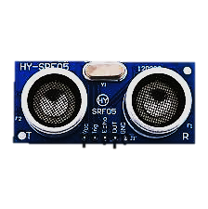
SRF-05
SRF05 is an ultrasonic rangefinder, and you can use this module to determine the exact distance of an obstacle.
You can send a trigger pulse through a base and receive an echo signal.
Voltage : DC5V Static current : less than 2mA level output: high-5V
16

Slide 25

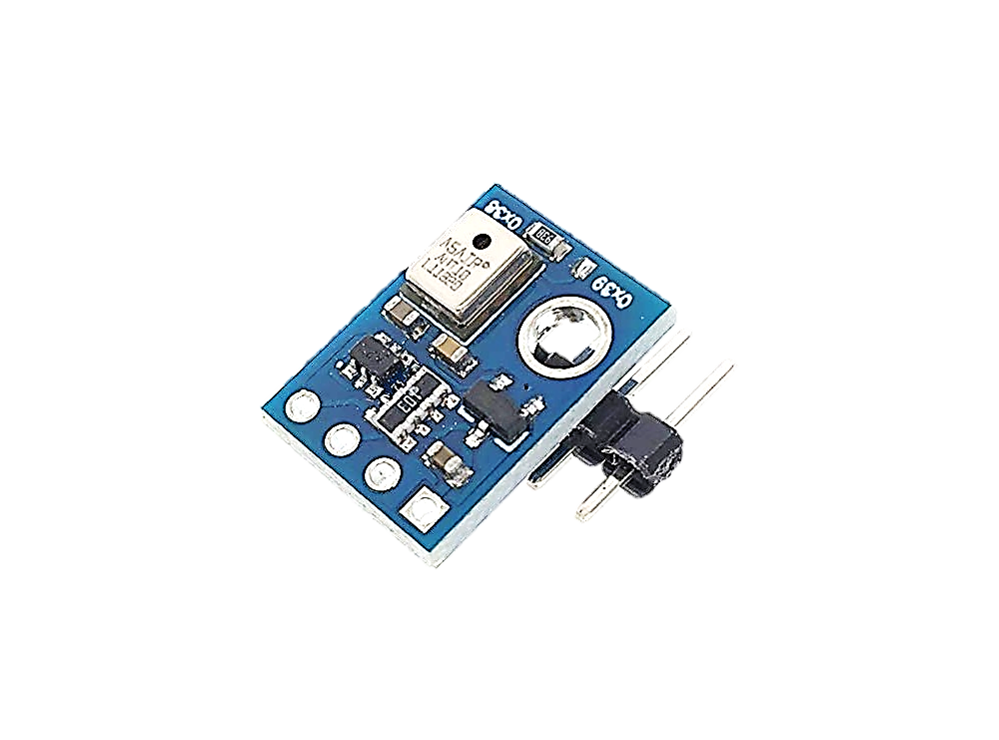
AHT-10
The sensor outputs a calibrated digital signal in standard I 2 C format.
The first generation of temperature and humidity sensors have been improved to make them more stable in harsh environments.
Its performance has been greatly improved beyond the reliability level of previous generation sensors.
Working voltage: 1.8 - 6.0 V
Humidity accuracy: typical ± 2% Humidity resolution: 0.024% Temperature accuracy: typical ± 0.3 ° C Temperature resolution: Typical 0.01 °C
17

Slide 26

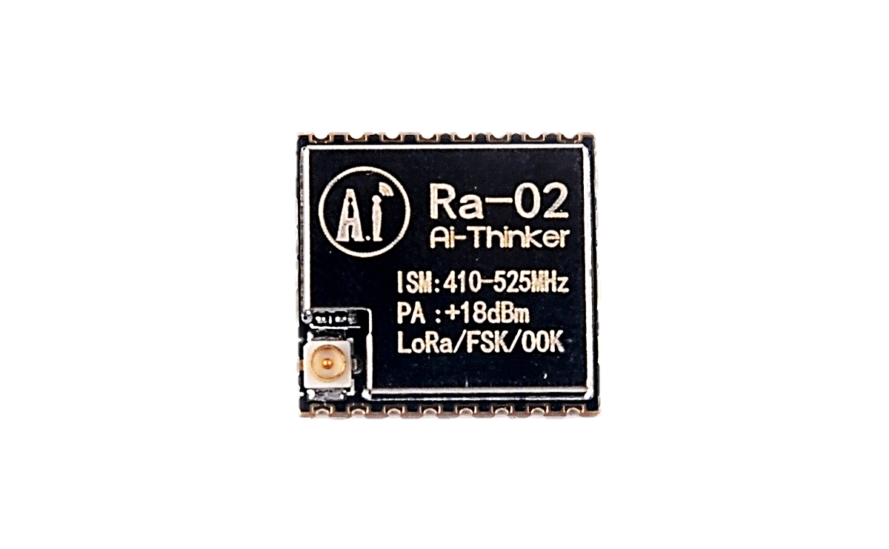
LORA Ra-02
The SX1276/77/78/79 transceivers feature the LoRaTM long range modem that provides ultra-long range spread spectrum communication and high interference immunity whilst minimising current consumption.
+ 18dBm-100mW when constant voltage RF power output
High sensitivity: up to -148dBm
Half-duplex SPI communications
,ect.
18

Slide 27
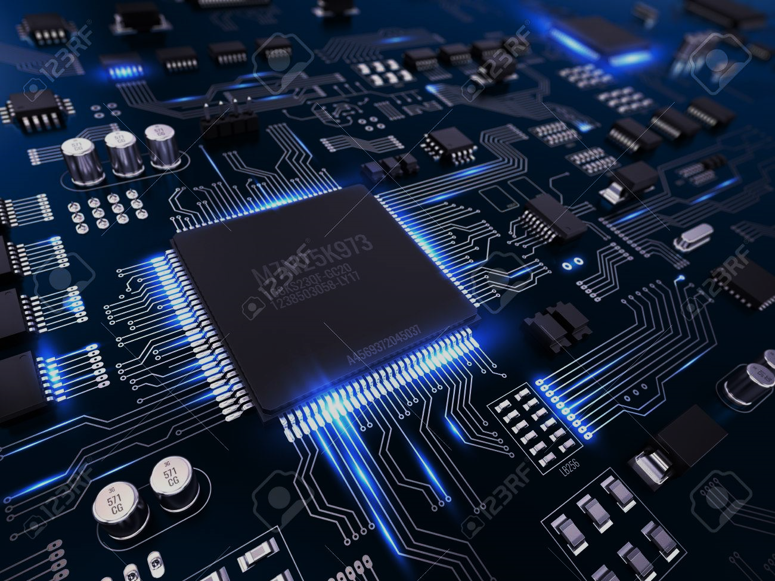
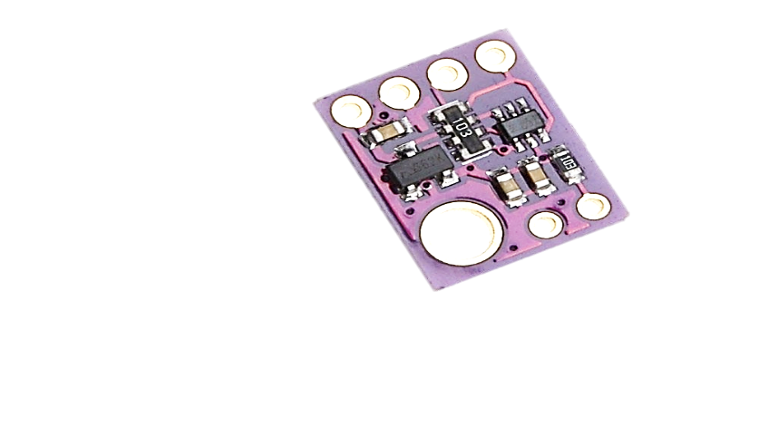
GY-49
The MAX44009 ambient light sensor features an I2C digital output that is ideal for a number of portable applications such as smartphones, notebooks, and industrial sensors.
At less than 1μA operating current, it is the lowest power ambient light sensor in the industry and features an ultra-wide 22-bit dynamic range from 0.045 lux to 188,000 lux.
The adaptive gain block automatically selects the correct lux range to optimize the counts/lux.
The IC is designed to operate from a 1.7V to 3.6V supply voltage range and consumes only 0.65μA in full operation.
19

Slide 28
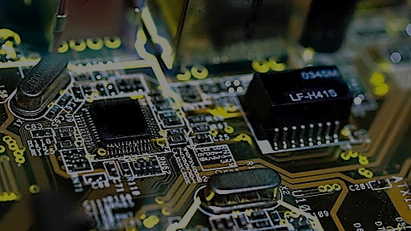
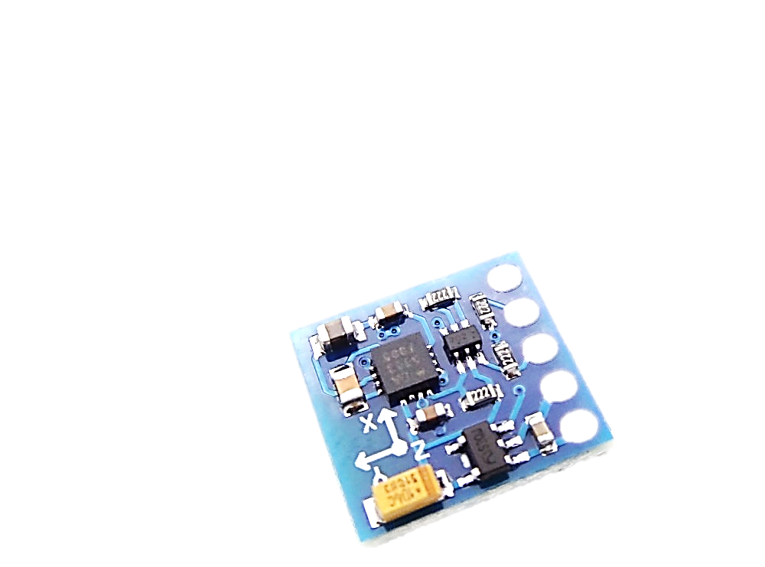
GY-271
3-Axis Magnetoresistive Sensors and ASIC in a 3.0x3.0x0.9mm LCC Surface Mount Package. 12-Bit ADC Coupled with Low Noise AMR Sensors Achieves 2 milli-gauss Field Resolution in ±8 Gauss Fields Built-In Self Test.
Low Voltage Operations (2.16 to 3.6V) and Low
Power Consumption (100 μA)
I2C Digital Interface
Wide Magnetic Field Range (+/-8 Oe)
20

Slide 29
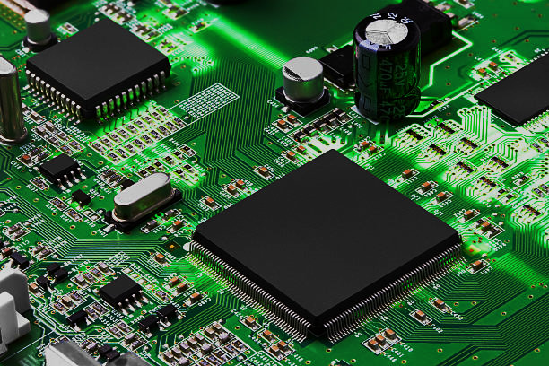
Hardware Design

Slide 30

Introduction to Altium Designer
Altium is an Australian-based software company that produces electronic design for software engineers. Founded in 1985, the company is headquartered in Sydney and has sales offices in the United States, Europe, Japan and China, as well as sales representatives in most major markets. Until 2001, the company was known as Protel.
This software is one of the most important and popular for electronic engineers. One of its common uses among 90% of electronic engineers is the use of schematic design and PCB printing. Of course, the efficiency of this software is not limited to these two parts. There is also an analysis section, FPGA, etc.
21

Slide 31
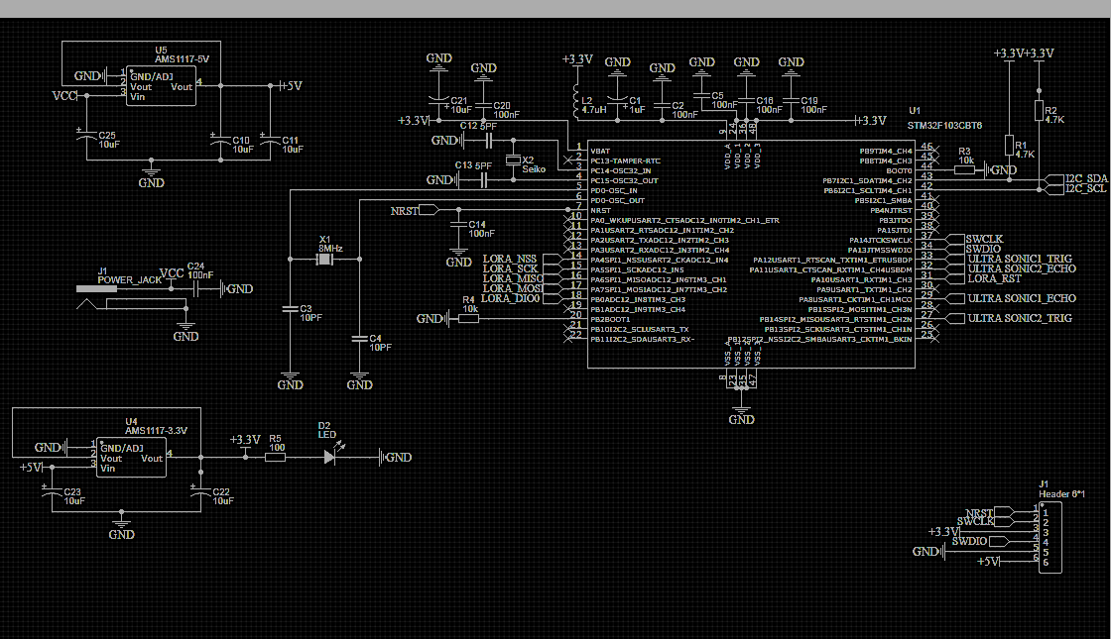
Transmiter Shematic(1)
22

Slide 32
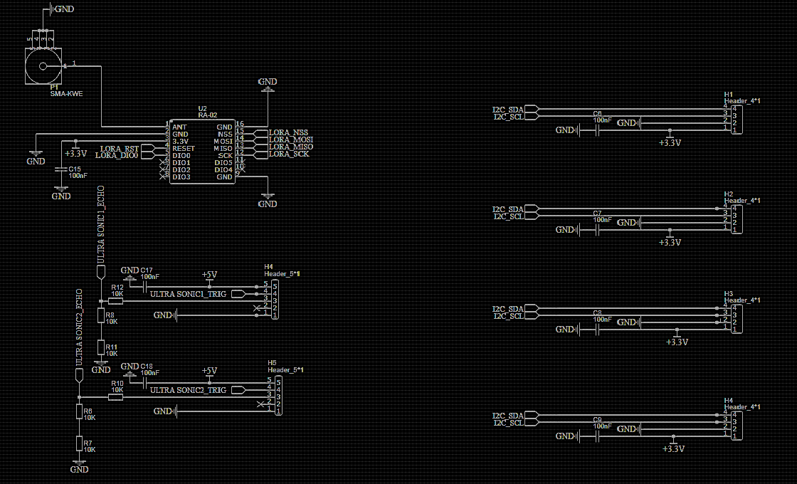
Transmiter Shematic(2)
23

Slide 33
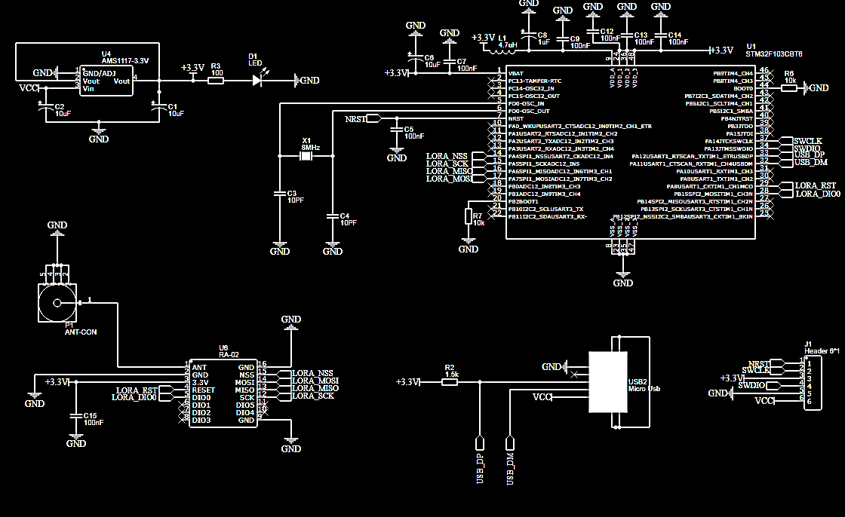
Reciver Shematic
24

Slide 34
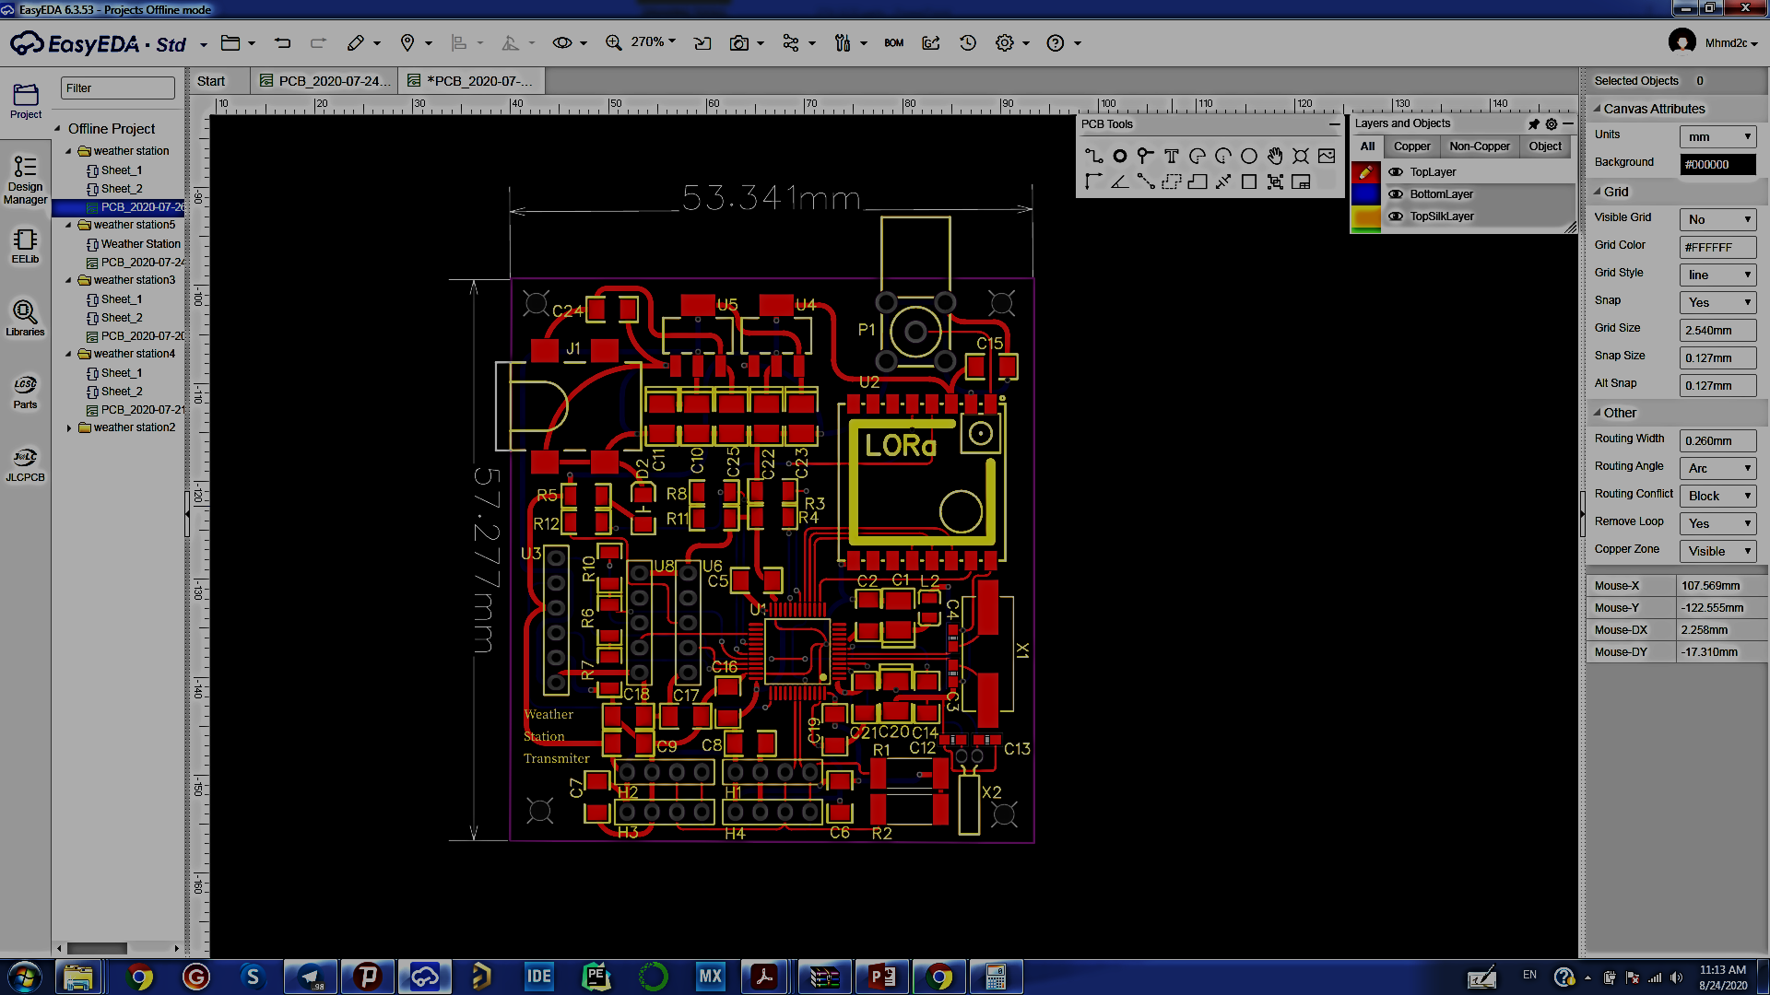
Transmiter PCB
25

Slide 35
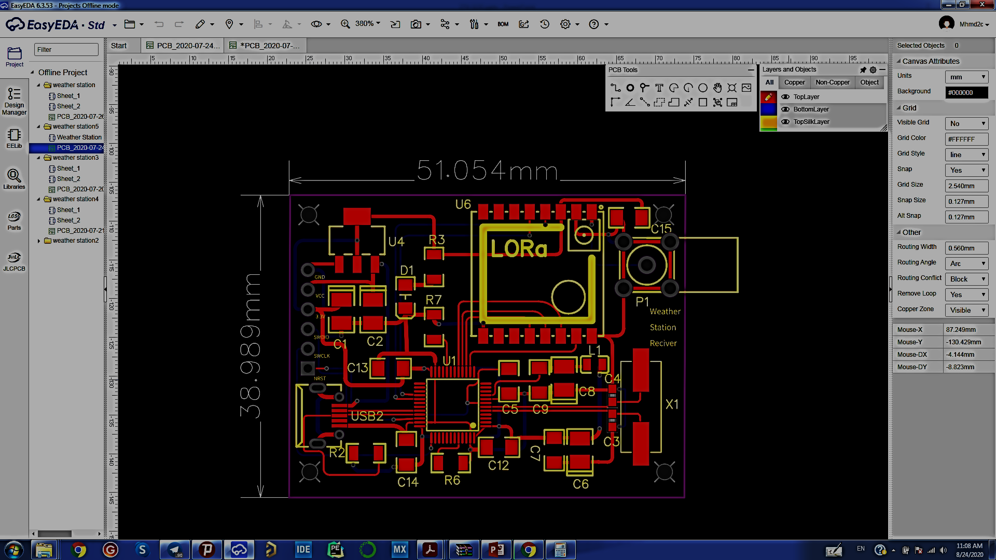
Reciver PCB
26

Slide 36

Desktop App

Slide 37


Introduction to Python
Simplicity: learning, reading and maintaining
Extensive libraries for a variety of applications
A very large community
The most popular programming language in 2020
Examples of applications:
Data Science (Numpy, SciPy, Pandas)
Machine learning (scikitlearn, Tensorflow, Keras,
PyTorch )
Web Development (Django, Flask)
Computer game development (PyGame)
27

Slide 38

PyQt
PyQt is a Python binding of the cross-platform GUI toolkit Qt, implemented as a Python plug-in. PyQt is free software developed by the British firm Riverbank Computing. It is available under similar terms to Qt versions older than 4.5; this means a variety of licenses including GNU General Public License (GPL) and commercial license, but not the GNU Lesser General Public License (LGPL). PyQt supports Microsoft Windows as well as various flavours of UNIX, including Linux and MacOS (or Darwin).
PyQt implements around 440 classes and over 6,000 functions and methods including:
a substantial set of GUI widgets
classes for accessing SQL databases (ODBC, MySQL, PostgreSQL, Oracle, SQLite)
QScintilla, Scintilla-based rich text editor widget
data aware widgets that are automatically populated from a database
an XML parser
SVG support
classes for embedding ActiveX controls on Windows (only in commercial version)
28

Slide 39
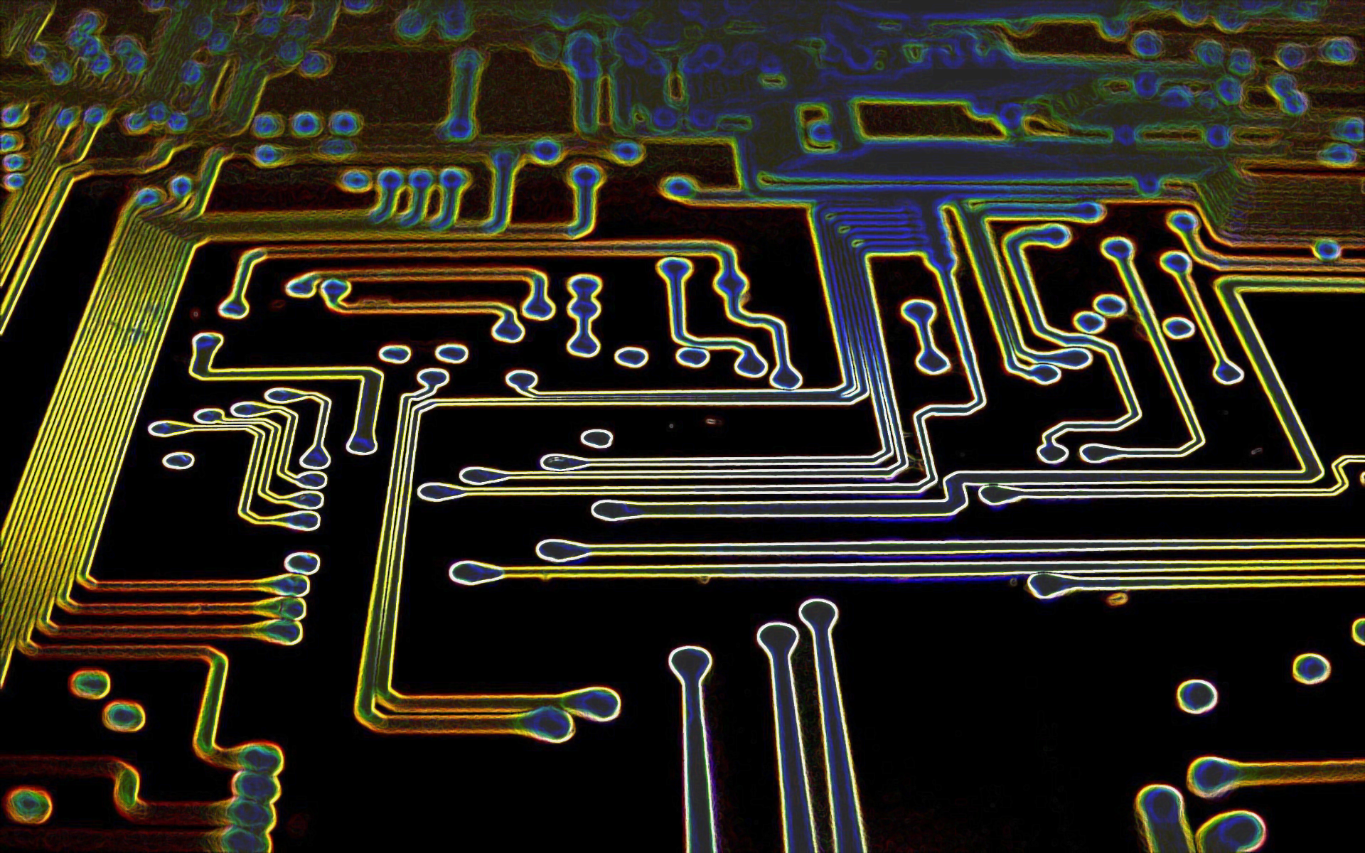
sources and resources
All references, codes and datasheets are placed on the GitHub site at a https://github.com/jmdmahdi/Weather-Station address
29

Slide 40

Contact us
Telegram: @mhmmd2c, @jmmahdi
Instagram: mhmmd2c, jmmahdi
Gmail:mhmd2c1998@gmail.com, jmdmahdi@gmail.com
Linkedin: mohammadebrahimebrahimtoosi
30

Slide 41
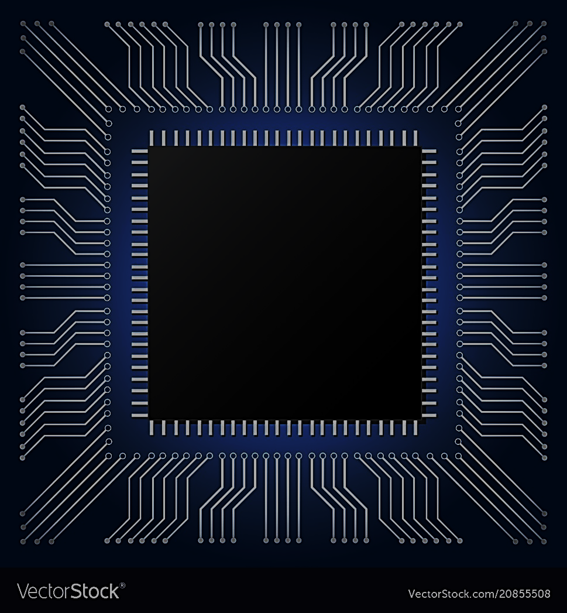
THE END

